Slide 1




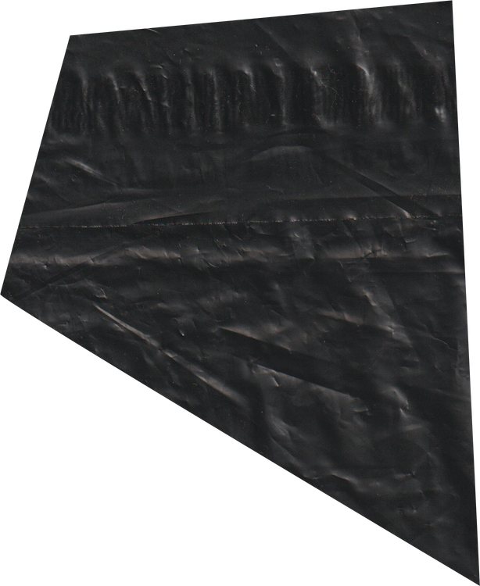
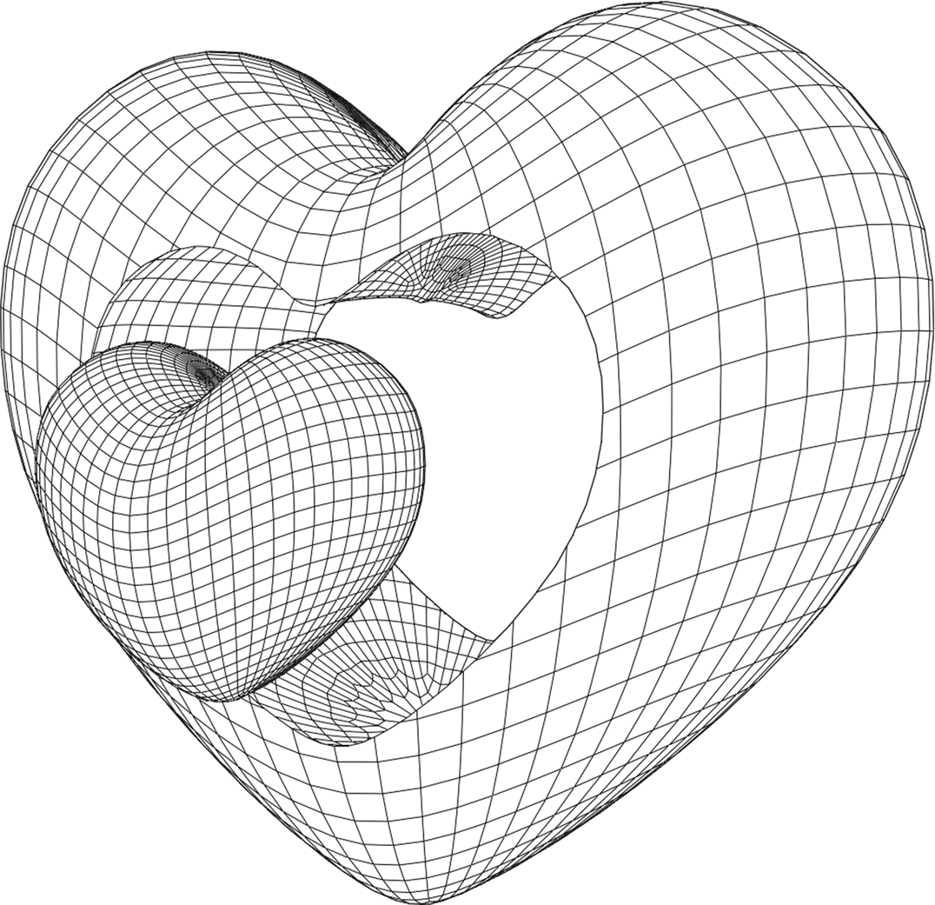
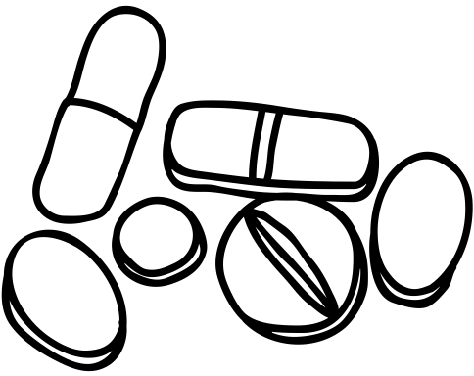

ARUJ PUNIA
2310994767
SMART MEDICINE REMINDER KIT WITH HEALTH MONITORING
PROJECT PITCH
PROJECT

Slide 2

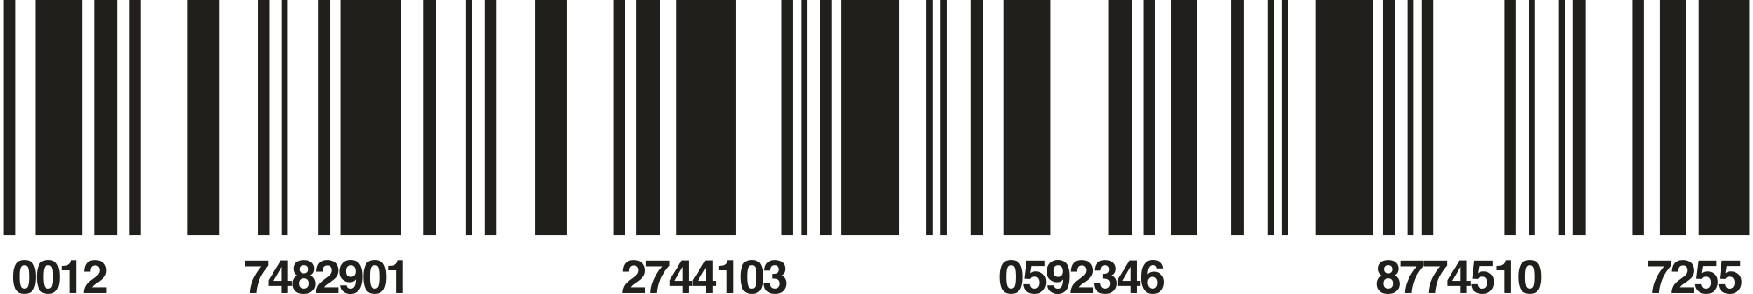
TABLE OF CONTENT
1
PROBLEM DOMAIN
5
COMPONENTS
2
CHALLENGES IN CURRENT SYSTEM
6
COMMUNICATION PROTOCOLS
3
GAPS AND OPPORTUNITIES FOR EMBEDDED SYSTEMS
7
EVALUATION CRITERIA
4
PROPOSED EMBEDDED SYSTEM SOLUTION
8
BLOCK DIAGRAM

Slide 3
PROBLEM DOMAIN
MEDICATION ADHERENCE FOR ELDERLY PATIENTS:
HEALTH MONITORING AND EMERGENCY ALERTS:
ENVIRONMENTAL MONITORING
USER-FRIENDLY INTERFACES:
Ensuring elderly patients take medications on time.
Real-time tracking of vital signs (heart rate, temperature, oxygen).
Checking air quality and room conditions for medication safety
Simplifying systems for elderly and illiterate users

Slide 4
CHALLENGES IN CURRENT SYSTEM
User-Friendliness: Elderly or illiterate users may struggle with setting up or operating the system, even if it has a mobile app interface.
Dependence on Cellular Networks: The GSM module’s reliance on cellular networks for phone call alerts may be problematic in areas with poor signal strength.
Limited Scalability: The current system is designed for individual use, lacking multi-user support, which can be inefficient for hospitals or families with multiple patients.
Hardware Costs: While affordable, further reduction in cost is needed for widespread adoption, especially in low-income regions.
Battery and Power Reliability: Ensuring continuous operation, especially in power outages, remains a challenge as many of the system components rely on a steady power source.

Slide 5
GAPS AND OPPORTUNITIES FOR EMBEDDED SYSTEMS
GAPS
Interoperability: Many embedded healthcare devices lack standard protocols for seamless integration with other medical systems or devices.
Energy Efficiency: Power consumption in battery-operated devices is still a challenge, especially for remote or wearable systems.
Limited Connectivity: Dependence on local networks (Wi-Fi, GSM) without robust failover options can result in downtime in critical healthcare environments.
Security and Privacy: Embedded systems in healthcare often face challenges in securing patient data, especially when transmitting sensitive health information.
Scalability: Current embedded systems are often designed for single-use applications, limiting their scalability in multi-user environments like hospitals.

Slide 6
GAPS AND OPPORTUNITIES FOR EMBEDDED SYSTEMS
OPPORTUNITIES
AI Integration: Embedding AI for predictive analysis of health conditions could improve real-time decision-making and automate health monitoring.
Edge Computing: Utilizing edge devices to process data locally reduces latency and reliance on cloud servers, making systems more responsive and efficient.
Wearable Technology: Expanding into wearable embedded systems offers continuous health monitoring with features like real-time alerts and integration with telemedicine platforms.
Energy Harvesting: Leveraging energy-harvesting technologies to power embedded systems could reduce the dependence on traditional batteries, especially in remote areas.
Modular Designs: Developing modular embedded systems that can be easily upgraded or customized for different healthcare applications opens up versatility and long-term adaptability.

Slide 7
PROPOSED EMBEDDED SYSTEMS SOLUTIONS
Interoperability via Standardized Protocols: Implementing open standards like MQTT or BLE (Bluetooth Low Energy) to ensure compatibility between various healthcare devices and systems for seamless data exchange.
Low-Power Design with Energy-Efficient Components: Utilizing ultra-low-power microcontrollers (e.g., ARM Cortex-M series) and energy-efficient sensors to extend battery life in remote or wearable systems.
Hybrid Connectivity: Combining Wi-Fi, GSM, and LPWAN (LoRa, NB-IoT) in embedded systems to ensure reliable communication, even in areas with poor network coverage.
Enhanced Security Framework: Integrating hardware-level encryption and secure boot features in embedded systems to safeguard patient data during transmission and storage, meeting privacy regulations like HIPAA.
AI at the Edge: Embedding lightweight AI models on microcontrollers (e.g., TinyML) for real-time health monitoring and predictive analytics, enabling faster local processing without cloud dependency.
Wearable Embedded Devices: Designing compact, comfortable wearable devices with integrated sensors for continuous health monitoring (e.g., ECG, SpO2), with data sent to a central system for analysis.
Energy Harvesting Systems: Incorporating energy-harvesting techniques (e.g., solar, kinetic) to power embedded systems, reducing the need for frequent battery replacement in remote healthcare applications.
Modular Embedded Platforms: Creating modular embedded systems with swappable sensors and communication modules, allowing for easy upgrades and customization based on specific healthcare needs.

Slide 8
COMPONENTS
COMPONENT
COMPONENT
COMPONENT
ESP32 (1)
LCD (I2C INTEGRATED) (1)
LED (10)
ARDUINO NANO (1)
DHT11 HUMIDIFIER + TEMPERATURE SENSOR (1)
BUZZER (8)
GSM MODULE (1)
MQ2 GAS SENSOR (1)
TRANSISTOR (2)
ISD1820 MODULE (1)
RTC MODULE (1)
CAPACITOR (1)
MAX30100 PULSE OXIMETER AND HEART RATE SENSOR (1)
IC7805 (2)
RESISTOR
LM35 BODY TEMPERATURE SENSOR (1)
BUCK CONVERTER (1)
SWITCH (1)

Slide 9
1. I2C (INTER-INTEGRATED CIRCUIT)
2. SPI (SERIAL PERIPHERAL INTERFACE)
POTENTIAL COMMUNICATION PROTOCOLS
Use Case: Sensor and peripheral communication (e.g., temperature, heart rate sensors).
Features: Two-wire protocol (SDA, SCL), supports multiple devices on the same bus, used for short-distance communication.
Opportunities: Ideal for low-power, low-speed communication between microcontrollers and sensors in embedded healthcare devices.
Use Case: High-speed communication between microcontrollers and peripherals (e.g., displays, flash memory).
Features: Full-duplex, faster than I2C, requires more wires (MISO, MOSI, SCLK, SS).
Opportunities: Suitable for systems requiring high data transfer rates like image or signal processing in medical devices.
1. MOBILE APP INTERFACE
2. LCD/LED DISPLAY ON DEVICE
Dashboard: Displays medication schedule, health metrics (e.g., heart rate, oxygen level), and environmental conditions (e.g., room temperature).
Notifications: Push notifications and alerts for missed medications, abnormal health readings, or unsafe environmental conditions.
User Input: Simple forms for setting medication schedules, adjusting alert preferences, and monitoring health data.
Voice Commands: Integrates with virtual assistants (e.g., Google Assistant, Siri) for hands-free operation, especially useful for elderly users.
Basic Information: Displays real-time clock, next medication time, and health data like heart rate or temperature.
Visual Alerts: Color-coded LED indicators for status (e.g., green for normal, red for missed medication).
Touch or Button Interface: Simple navigation for elderly users, with minimal steps to check or modify schedules and view health data.
Use Case: Sensor and peripheral communication (e.g., temperature, heart rate sensors).
Features: Two-wire protocol (SDA, SCL), supports multiple devices on the same bus, used for short-distance communication.
Opportunities: Ideal for low-power, low-speed communication between microcontrollers and sensors in embedded healthcare devices.

Slide 10
EVALUATION CRITERIA
DESIGN FOR FAULT
HARDWARE
AWARE DESIGN
TOLERANCE
DESIGN FOR PERFOMANCE
QUALITY OF SERVICE
RELIABLE
ROBUST

Slide 11
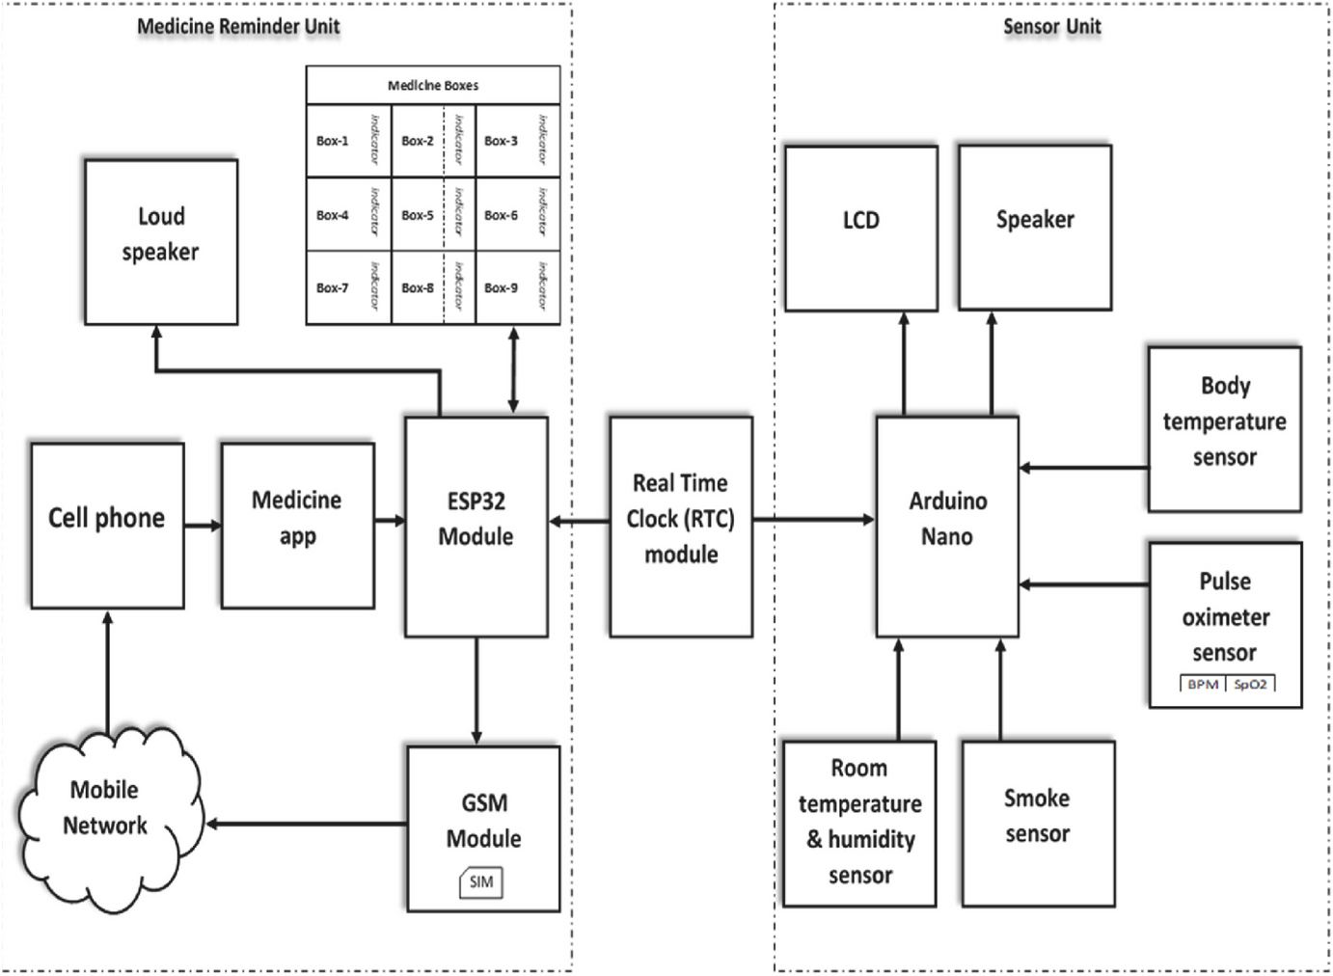
BLOCK DIAGRAM

Slide 12
THANK YOU

